Slide 1

INSTAGRAM USER ANALYTICS

Slide 2




AGENDA
INTRODUCTION
PROJECT DESCRIPTION APPROACH
TECH-STACK USED
INSIGHTS RESULT
CONCLUSION OF THE ANALYSIS

Slide 3



PROJECT DESCRIPTION
We will analyze Instagram user data to uncover insights that inform product decisions. Using SQL, we will query the database to answer questions about user behaviour.
Our analysis will extract patterns and trends from the data.
The insights will be presented in a report to the Instagram team. It will summarize our methodology, key findings, and recommendations.
The goal is to leverage SQL to transform Instagram's raw data into actionable insights. These data-driven insights will assist the product team in enhancing the app.
Let me know if you need me to expand or clarify any part of this condensed description. I'm happy to provide more details where needed.

Slide 4


APPROACH
The project was executed in a systematic manner following standard data analysis protocols:
First, the provided Instagram database tables were imported into MySQL Workbench for manipulation using SQL queries. The schema and relationships between tables were inspected to determine analysis strategies.
Next, a detailed examination of the business questions was conducted. SQL queries were planned out to extract the required data fields and calculations to obtain the answers.
The queries were written in MySQL to pull the relevant user statistics and metrics from the database. Extensive testing and optimization was undertaken to ensure efficient, accurate query execution.
Once the SQL queries were finalized, they were validated by verifying the output results and summary statistics. This ensured integrity of the extracted data for analysis.
The query results were analyzed using an objective, data-driven approach. Trends, outliers, and patterns were identified in the user metrics to develop meaningful analytical conclusions.
Finally, the key technical details, methodology, and analysis findings were consolidated into a presentation. This summarized the analytical process and highlighted impactful insights for Instagram's product team.

Slide 5


TECH-STACK USED
MySQL Workbench (v8.0.33) enabled visual database management. SQL provided data query and analysis capabilities.
MySQL Workbench allowed efficient import and inspection of the Instagram dataset. SQL was used to write optimized queries that extracted user metrics and insights from the database.
These technologies were selected due to their widespread use in data analytics. MySQL is a leading relational database. SQL is the standard language for data manipulation and analysis.
Together, MySQL Workbench and SQL provided the necessary data storage, querying, and analysis functionality required for this project in a reliable and scalable manner.

Slide 6

INSIGHTS
Marketing Analysis:
Loyal User Reward Inactive User Engagement
Contest Winner Declaration Hashtag Research
Ad Campaign Launch
Investor Metrics:
User Engagement Bots & Fake Accounts

Slide 7


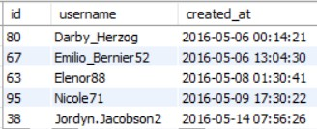


INSIGHTS
A)MARKETING ANALYSIS:
>_ 1. Loyal User Reward (Oldest 5 users) :
People who have using the app for long time
>_ Top 5 oldest users of Instagram from the database are :
SELECT *
FROM users
ORDER BY created_at ASC LIMIT 5 ;

Slide 8


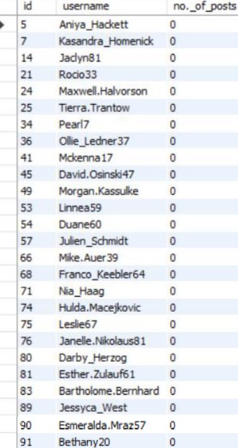
INSIGHTS
>_ 2.Remind Inactive Users to Start Posting: By encouraging them via email to publish their first image.
>_ The users who have never posted a single photo on Instagram
SELECT u.id,
u.username, Count(p.user_id) AS 'no._of_posts'
FROM users u
LEFT JOIN photos p ON u.id = p.user_id GROUP BY u.id
HAVING Count(p.user_id) = 0;

Slide 9


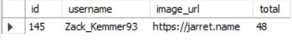
INSIGHTS
>_ 3.Declaring Contest Winner:The contest was
created by the team, and the winner will be the person who receives the most likes on a single photo.
>_ Details of the winner of the contest are :
SELECT
photos.id, username, photos.image_url, COUNT(*) AS total FROM photos INNER JOIN likes
ON likes.photo_id = photos.id INNER JOIN users
ON photos.user_id = users.id GROUP BY photos.id
ORDER BY total DESC LIMIT 1;

Slide 10

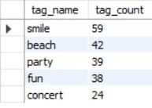
INSIGHTS
>_ 4. Hashtag Research: A partner brand wants to know,which hashtags to use in the post to reach the most people on the platform
>_ Top 5 most commonly used hashtags on the platform are :
SELECT t.tag_name, COUNT(*) AS tag_count FROM photo_tags pt
INNER JOIN tags t ON pt.tag_id = t.id GROUP BY t.id
ORDER BY tag_count DESC LIMIT 5;

Slide 11


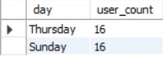
INSIGHTS
>_ 5.Launch AD Campaign: The team wants to know, which day would be the best day to launch ADs.
>_ Day of the week do most users register on :
SELECT DAYNAME(created_at) AS day, COUNT(*) AS user_count
FROM users GROUP BY day
ORDER BY user_count DESC LIMIT 2;

Slide 12
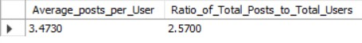
INSIGHTS
B)INVESTOR METRICS:
>_ 1.User Engagement: Are users still as active and post on Instagram or they are making fewer posts.
>_ Average user posts and ratio of total posts to total users in Instagram are :
SELECT (SELECT Count(id)
FROM photos) / (SELECT Count(DISTINCT user_id) FROM photos) AS Average_posts_per_User, (SELECT Count(id)
FROM photos) / (SELECT Count(id) FROM users) AS
Ratio_of_Total_Posts_to_Total_Users;

Slide 13

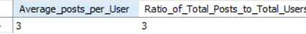
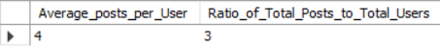
INSIGHTS
>_ If we use ROUND() OR CEILING() we can round decimal numbers like th so the output willl be this :
ROUND( ) :
SELECT
ROUND((SELECT COUNT(*)
FROM photos) / (SELECT COUNT(DISTINCT user_id) FROM photos)) AS Average_posts_per_User,
ROUND(SELECT COUNT(*)
FROM photos) / (SELECT COUNT(*)
FROM users)) AS Ratio_of_Total_Posts_to_Total_Users;
CEILING( ) :
SELECT
CEILING((SELECT COUNT(*)
FROM photos) / (SELECT COUNT(DISTINCT user_id) FROM photos)) AS Average_posts_per_User,
CEILING((SELECT COUNT(*)
FROM photos) / (SELECT COUNT(*)
FROM users)) AS Ratio_of_Total_Posts_to_Total_Users;

Slide 14
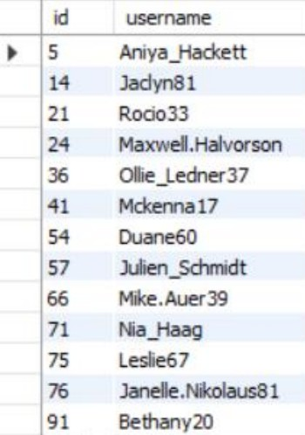
INSIGHTS
>_ 2.Bots & Fake Accounts: The investors want to know if the platform is crowded with fake and dummy accounts.
SELECT u.id, u.username FROM users u
JOIN likes l ON u.id = l.user_id GROUP BY u.id
HAVING COUNT(DISTINCT l.photo_id) = (SELECT
COUNT(*) FROM photos);
>_ Average user posts and ratio of total posts to total users in Instagram are :

Slide 15


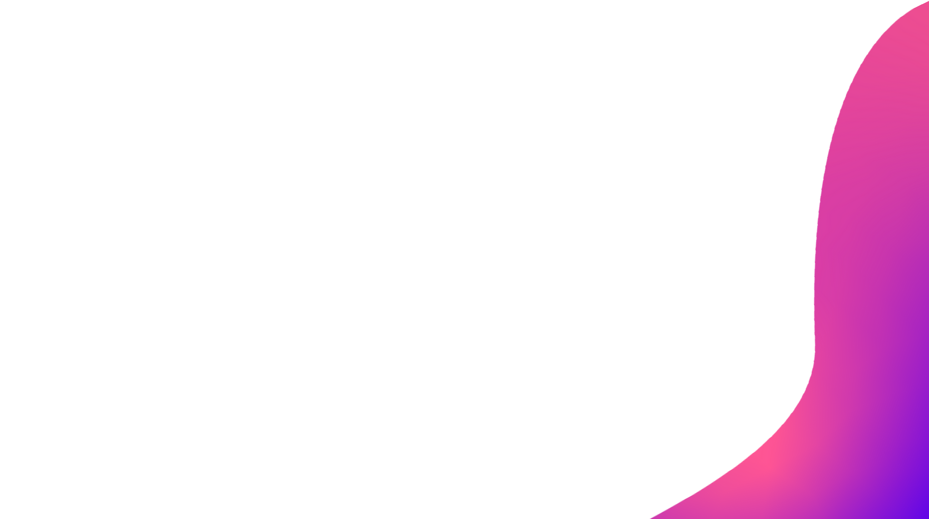

RESULT
Demonstrated proficiency in writing complex SQL queries across multiple tables to extract user data and metrics.
Developed skills in analyzing real-world production datasets at scale.
Uncovered actionable insights into Instagram user behaviors and trends to inform key decisions.
Created an analytical methodology replicable across other business datasets.
Showcased and strengthened core data analytics competencies in SQL and critical thinking.

Slide 16


CONCLUSION OF THE ANALYSIS
The marketing team should leverage the analysis findings to identify and reward highly loyal users, reach out to inactive accounts with promotions to reengage them, and capitalize on popular hashtags and high traffic days to amplify branding.
Monitoring user engagement KPIs like posts per user and activity levels provides Instagram with a measurable metric for growth and success that should continue being tracked.
Detecting and removing bot and fake accounts that artificially inflate numbers should be a priority to maintain a quality user experience and satisfaction.
In summary, the analysis provided specific, data-driven actions related to marketing, engagement, experience, and growth that Instagram's teams can implement based on the user insights uncovered through SQL querying.

Slide 17

THANK YOU
PRESENTED BY: CIRIL SHAJU

